Slide 1
Web Browser Lab

Slide 2
Web Browser Lab
Materials needed
Computer system connected to internet
Software Tools used
Firefox

Slide 3
Web Browser Lab
Lab Steps
Download and install Firefox
Install an add-on
Use the add-on
Go into Private Browsing and verify data isn't locally tracked
Set a Proxy
Open a certificate on a website and see the verified site
Show JavaScript associated with website
Clear cache, cookies, and history

Slide 4
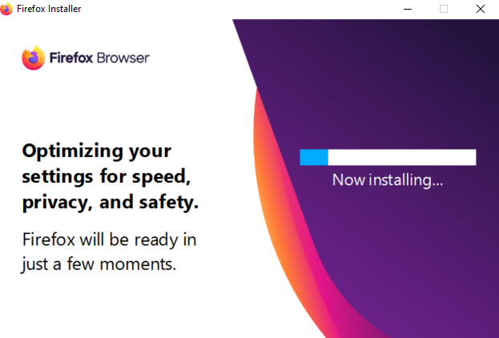
Web Browser Lab
Installing Firefox
For this lab, we'll be walking through using Firefox. As a user, you have many other options.
Open a web browser and go to www.mozilla.org
Click on the Download Firefox option
This should automatically download Firefox
Once downloaded, run through the installing process
Installing Firefox

Slide 5
Web Browser Lab
Add-ons/Extensions
Web Browsers have extra tools that can be added to the web browser to "enhance the experience"
One popular add-on is "AdBlock"
There are pros and cons to AdBlock.
A pro is you won't be bombarded with advertisements, especially annoying pop-ups.
A con is, websites like the New York Times recognizes AdBlock and prohibits you from using their site unless you subscribe or white-list them

Slide 6
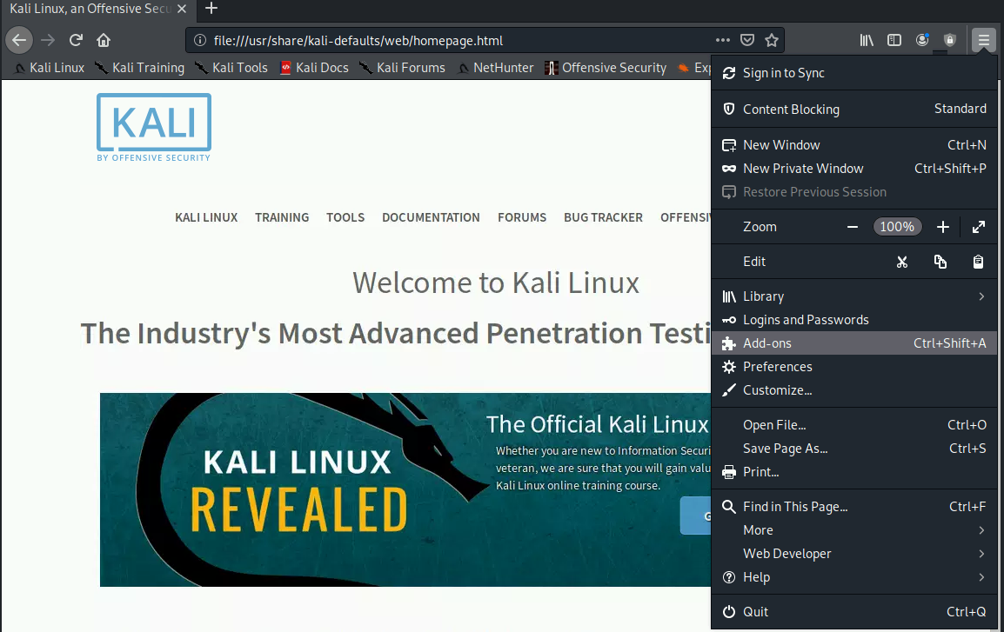
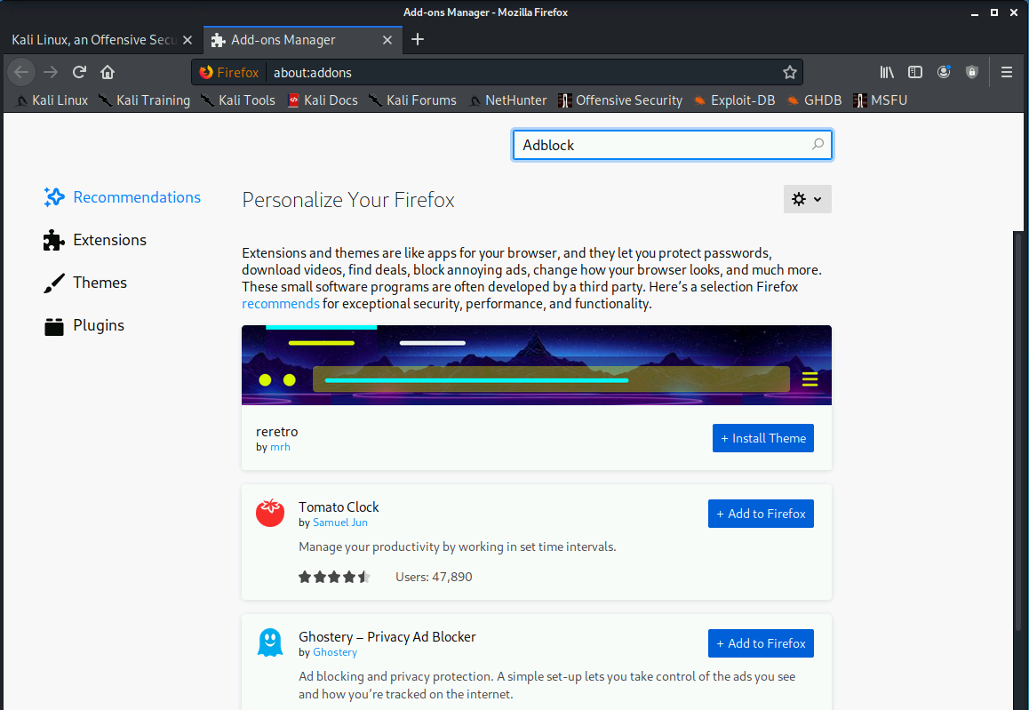
Web Browser Lab
Adding an add-on
Within Firefox you can enter Ctrl+Shift+A or click the menu (three bars) in the top right and select Add-ons
After this, type AdBlock in the search bar

Slide 7
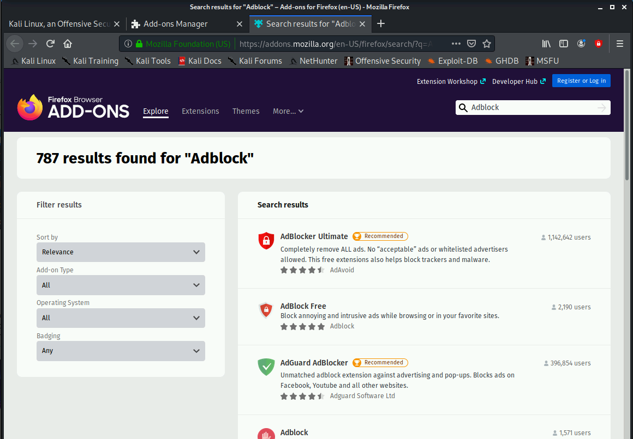
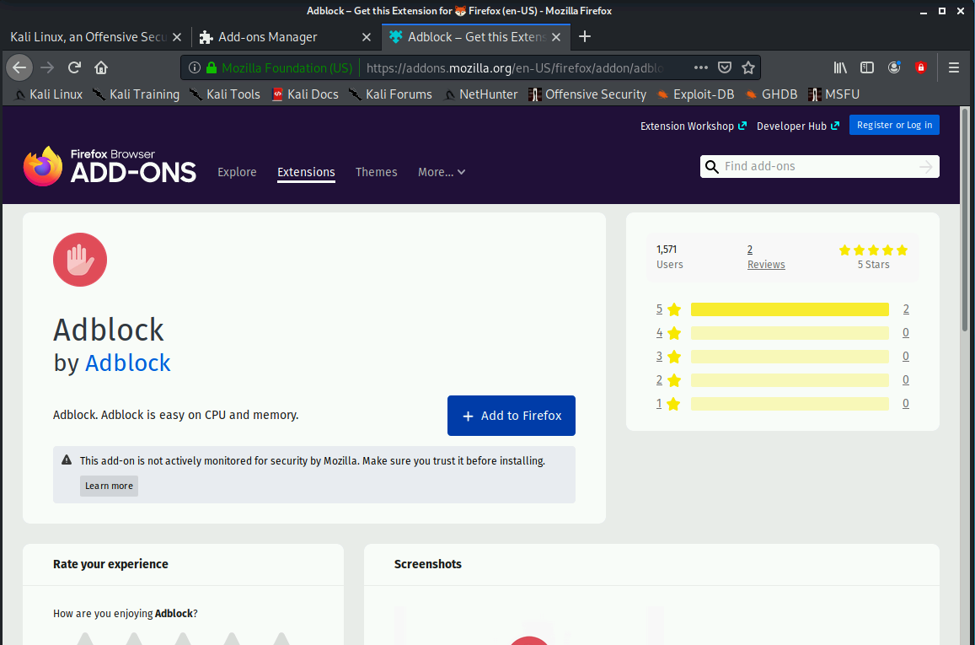
Web Browser Lab
Installing AdBlock
AdBlock is the fourth option as of the creation of this lab
Click AdBlock, then click Add to Chrome

Slide 8
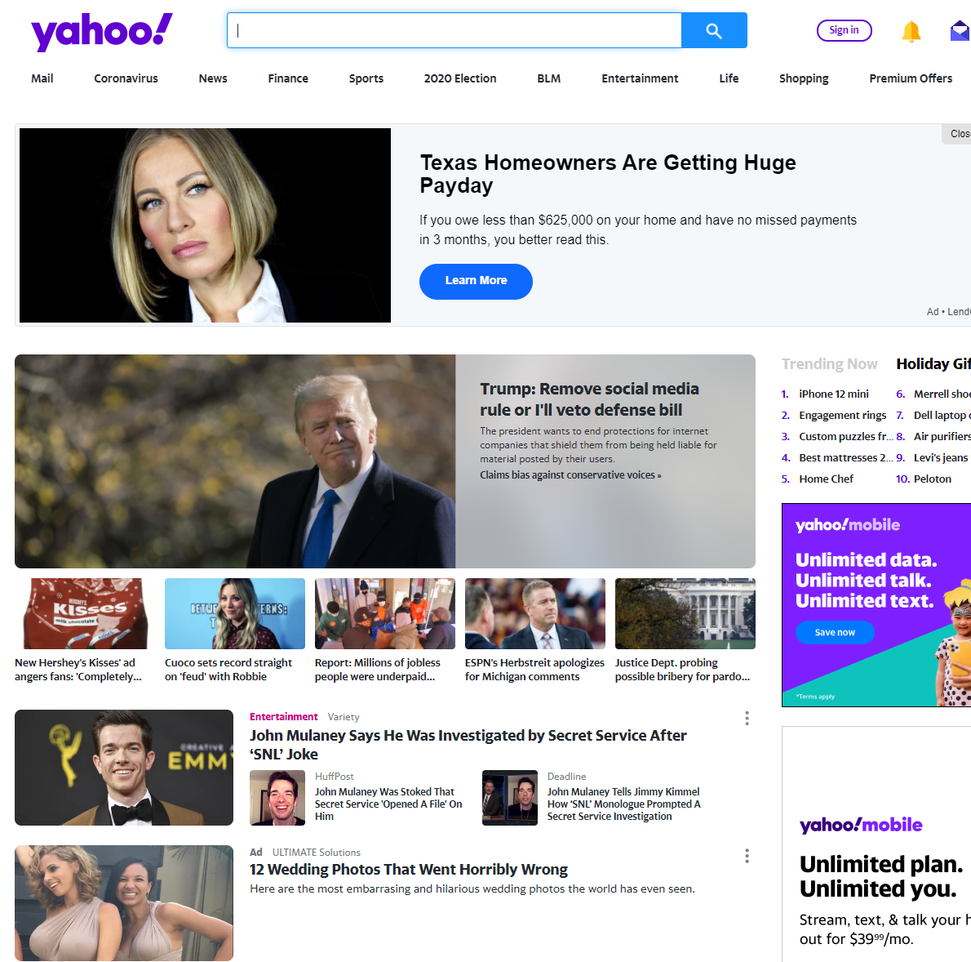
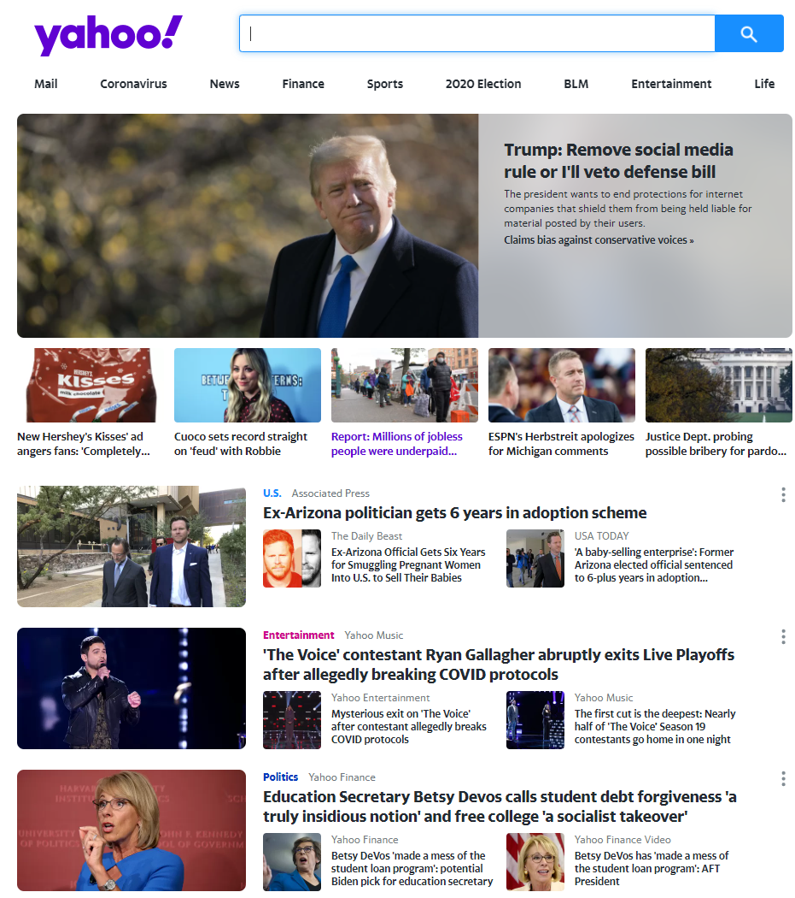
Web Browser Lab
Using AdBlock
Compare the left and right images to see yahoo.com before and after AdBlock

Slide 9
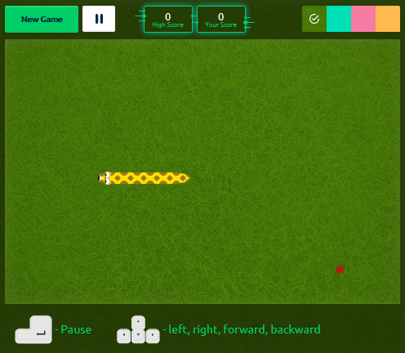
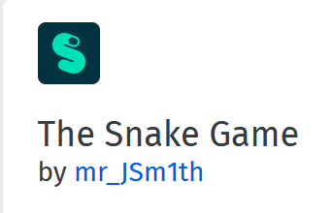
Web Browser Lab
Your turn - Installing an Add-on
Search for the add-on The Snake Game
Install the add-on and play the game
The Snake Game icon
Playing The Snake Game

Slide 10
Web Browser Lab
Private Mode/Incognito
When using a web browser, the websites (history) you visit, and cookies (embedded files) are stored.
Using Private Mode, the websites visited won't be stored and cookies will be removed once the session has ended
Private Mode is a safer way to use a web browser on a public computer, in case the user forgets to log out of a website

Slide 11
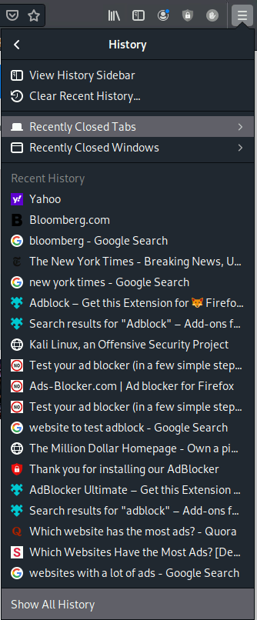
Web Browser Lab
Non-private mode
Before opening a private mode window, you can check your current history by clicking the menu bar in the top-right corner, followed by Library, then History

Slide 12
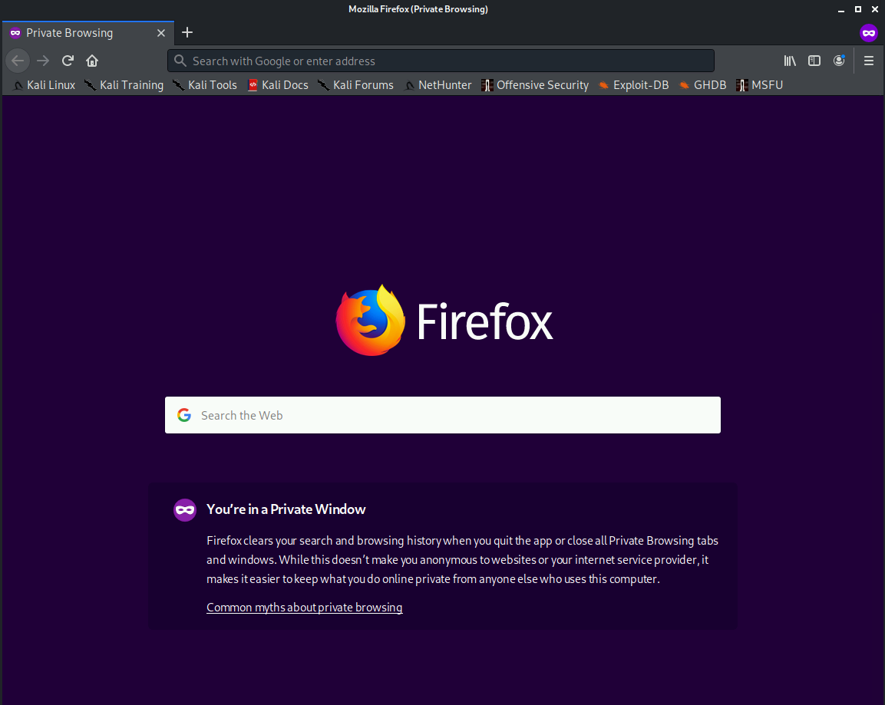
Web Browser Lab
Private Mode
To open a private mode window in Firefox, type Ctrl+Shift+P or use the menu tab and click New Private Window
Visit some websites and then recheck your history, nothing will have been saved

Slide 13
Web Browser Lab
Setting up a proxy
We chose Firefox for this lab for multiple reasons, one of which is the unique ability (in terms of web browsers) to set up a custom proxy server.
Accessing proxy settings is as follows:
Menu -> Options -> Advanced -> Network -> Settings (under Connection)

Slide 14
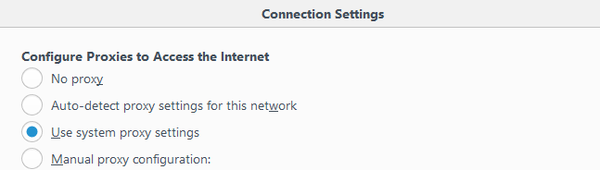
Web Browser Lab
Choosing your proxy
You'll be prompted with the four options

Slide 15
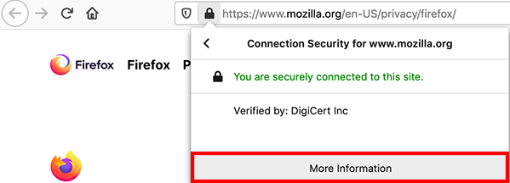
Web Browser Lab
Viewing certificates
With Firefox, viewing a certificate is straight-forward.
Click the lock icon in the address bar.
Click the right arrow in the site information drop-down panel.
Click the More Information button

Slide 16
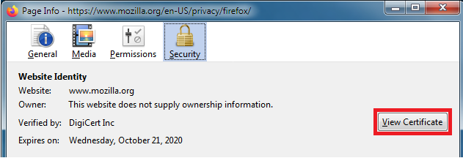
Web Browser Lab
Viewing Certificates
From the Security tab, click View Certificate
Detailed information about the certificate is displayed

Slide 17
Web Browser Lab
Your Turn - View a certificate
Go view the certificate for www.cyber.org
Who issued this certificate?
When is it no longer valid?

Slide 18
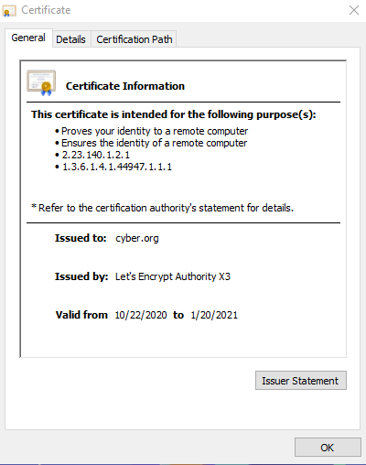
Web Browser Lab
Your Turn - View a certificate
Go view the certificate for www.cyber.org
Who issued this certificate?
When is it no longer valid?
You should notice it was issued by Let’s Encrypt Authority X3
This shows how long the certificate is valid for

Slide 19
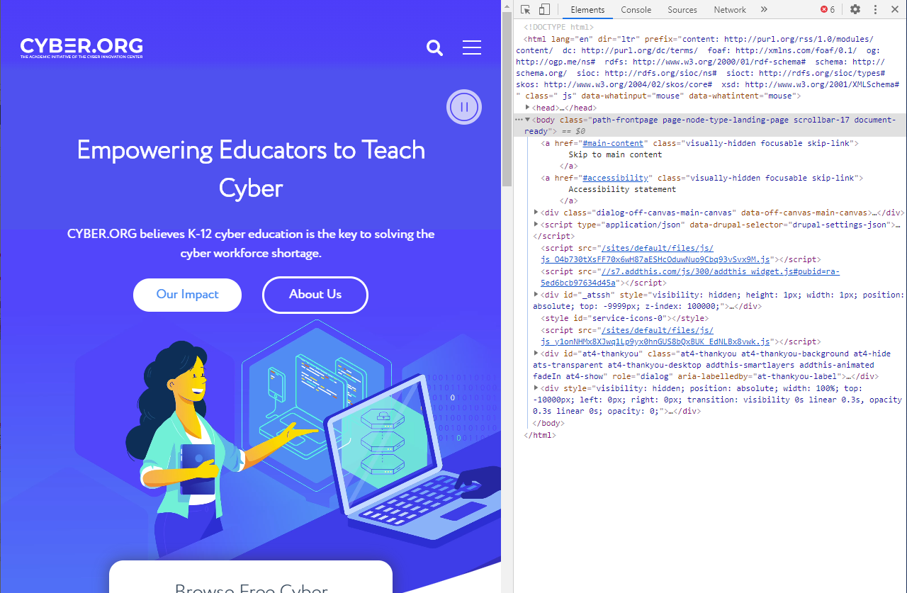
Web Browser Lab
Capital “i” as in Indiana
Viewing Javascript
Ctrl+Shift+I provides the JavaScript for the current website
For users interested in website design, this may be a useful tool to see how current sites are written
Viewing www.cyber.org’s JavaScript

Slide 20
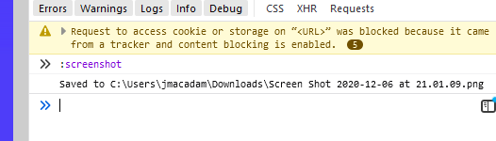
Web Browser Lab
Using Javascript
Click on the console tab
Use the following command:
:screenshot
Notice a screenshot of the current website was saved to the system

Slide 21
Web Browser Lab
Try This in the console tab
What is the purpose of the following two commands?
alert(“Hello, World!”)
navigator.userAgent

Slide 22

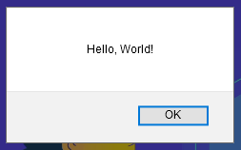

Web Browser Lab
Here is the results of the previous commands
alert() puts an alert inside of the web browser
navigator.userAgent gives information about the browser

Slide 23
Web Browser Lab
Clearing cache, cookies, and history
Occasionally a web browser may start to slow down or there may be an issue with an individual website. If this is the case, clearing cache, cookies, and history may help.
To clear everything, click the menu tab and select Settings. Click Privacy & Security, then select Clear Data.
You can verify everything has been cleared by checking your website history

